Slide 1
Hadi Dudley | Bentonville PL Jennifer Goodson| Fort Smith PL
Libraries Partner to Provide eBooks

Slide 2
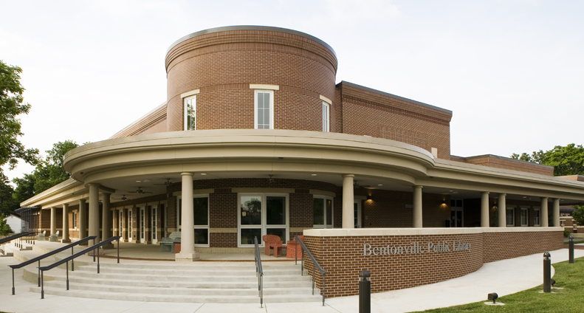
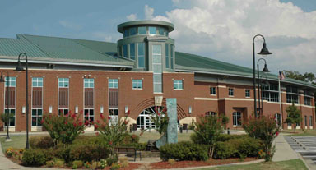
Libraries as Technology Providers
Public demand for digital technology
Challenge: high costs lead to opportunity
Identified Overdrive Media as solution

Slide 3
A Grassroots Partnership
Library Development District 1 (LDD1)
Various individual public libraries with separate governance & funding
20 member libraries
No legal affiliation
All different sizes: tiny to large
Stand-alone to multi-branch to county and regional systems

Slide 4
18 Member Consortium
Arkansas River Valley Regional Library System
Baxter County Library
Bella Vista Library
Bentonville Public Library
Boone County Library
Carroll and Madison Library System
Crawford County Library
Fayetteville Public Library
Fort Smith Public Library
Gentry Public Library
Gravette Public Library
Marion County Library
Newton County Library
Pope County Library
Rogers Public Library
Siloam Springs Public Library
Springdale Public Library
Washington County Library System

Slide 5
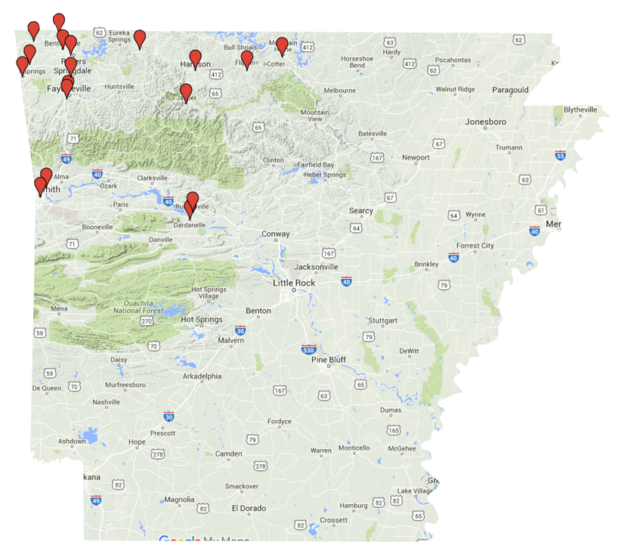
The Natural State

Slide 6
Equal Voices
Mutual understanding & extension of LDD1
Collaborative, respectful & positive
Informal agreements
Common goal, supportive partnership
Share costs for services & collection

Slide 7
Getting Started
Six Libraries in Fall 2008
Designated one person as vendor liaison
In-person meetings & email discussion list
ID & agree on loan limits & rules
Website design, logo & project name

Slide 8
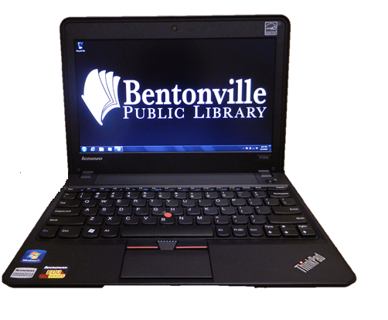
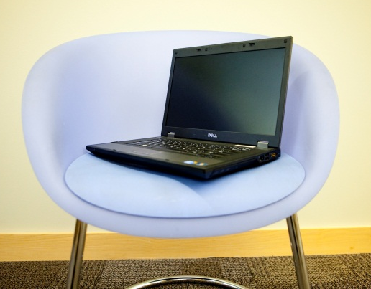
Making it Happen
Spring 2009 Launch!
Cooperation & customization
Marketing
Training: Staff & Patrons
Advantage accounts

Slide 9
Tips & Tricks for Downloading
Device specific
Step-by-step
Great tool for tech savvy patrons
Example of cooperation & customization

Slide 10
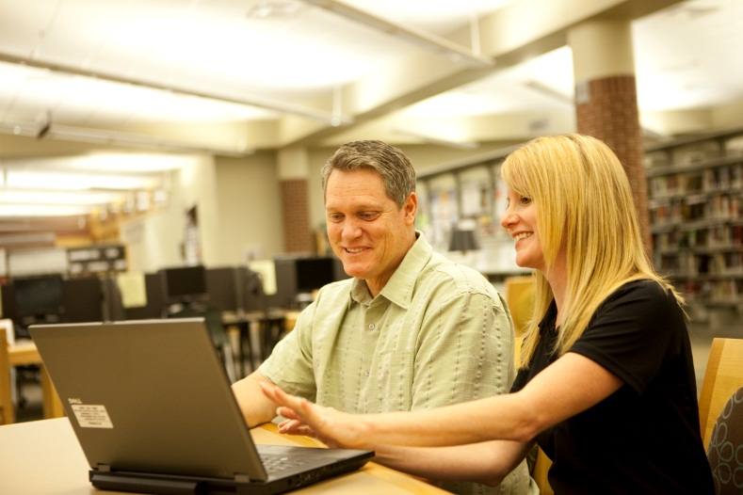
Library2Go Today …
Multiple media
Collection size: 21,000+
eBooks comprise 76% of collection
1.1 million checkouts
18 member libraries
Investment: $700,000+

Slide 11
The Partnership Continues
Changing environment requires ongoing cooperation
ePublishing industry
Overdrive services
Collection Use

Slide 12
Use Trends (by Month)

Slide 13
All Libraries Participate

Slide 14
Additional Partnerships
Freegal Music / Library Ideas
OneClick Digital / Recorded Books
Zinio / Recorded Books

Slide 15
You Can Do It Too!
Do not be afraid to partner
Strength in combined negotiations with vendors
Informal agreements worked for our group
Professional respect and cooperativeness
Think creatively for funding
Friends, civic groups, business sponsorship
Be flexible
Best-laid plans may need to be modified
Cooperation requires compromise

Slide 16
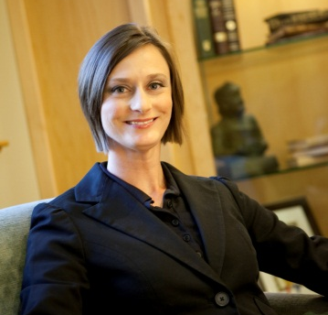
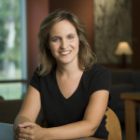
Questions & Contact Info
Hadi Dudley, Library Director
Bentonville Public Library
479-271-3194
hdudley@bentonvillear.com
Jennifer Goodson, Library Director
Fort Smith Public Library
479-783-0229
jgoodson@fortsmithlibrary.org

